Slide 1
BCSE401L: Internet of Things Module-4: Privacy and Security of Things Data
Dr. Anisha Natarajan
Assistant Professor
School of Electronics Engineering
anisha.natarajan@vit.ac.in

Slide 2
Introduction
Several devices communicate among themselves in an IoT network.
Nobody likes it if everyone knows our private data.
Therefore, things data needs to be anonymized before storing that in a hospital, bank, or government organization.
This ensures prevention from unauthorized manipulation even if illegitimate persons get hold of it.
There are several other examples of IoT applications like smart grid, smart manufacturing, smart transportation, and smart parking where there is a need to anonymize and secure the things data.
In particular, the chapter discusses data privacy, elliptic curve cryptography (ECC), and blockchain technology.

Slide 3
Data Privacy
The organization often maintains a database of the employees or users like name, age, gender, area code, health conditions, and many more.
Generally, the database has sensitive attributes like a disease of a patient in a hospital, income of a person in a government department, location of the user for a mobile network amongst others.
We anonymize data for research or analysis purposes.
The anonymized data must not disclose sensitive attributes like the name of disease and income of the user.
Also, at the same time, we should have enough information.
The data anonymization preserves the privacy of the user.

Slide 4
Data Anonymization Techniques
There are several techniques for data anonymization.
Among them, three common techniques are k-anonymity, l-diversity, and t-closeness.
In k-anonymity, each user is not distinguishable from at least k − 1 number of users in each block.
In l-diversity, there are at least l different sensitive attributes in each block.
A simple approach for anonymization is to suppress the name of the user.
However, the malicious user can extract the user’s sensitive attributes using non-sensitive attributes such as age, gender, or pin code of the user’s area and prior knowledge.

Slide 5
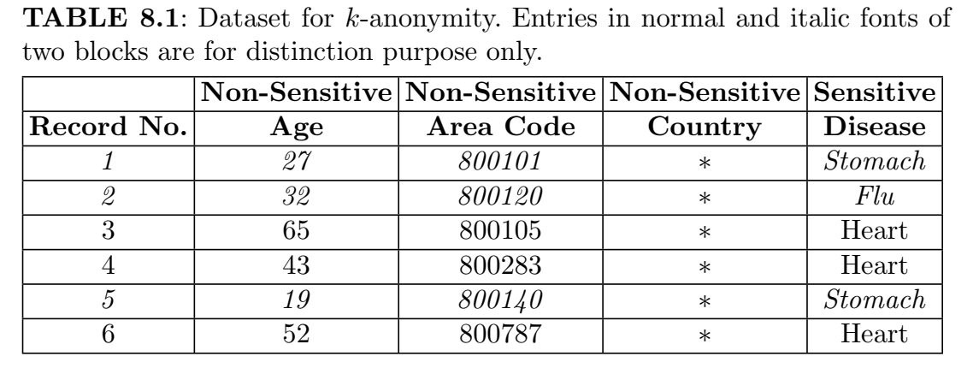
Privacy using k-anonymity

Slide 6
Privacy using k-anonymity
We do generalization and suppression to anonymize the data.
Consider a dataset as in Table 8.1 for anonymization purpose.
For example, if there are three records in each group, the non-sensitive attributes are generalized using less than or greater than some value, say, 30.
Further, some digits of non-sensitive area code are suppressed by asterisks.
The name of the country is completely suppressed.
In the 3-anonymized table, at least 2 records are not distinguishable with each record in each block.
Notably, the name of the person is suppressed to provide a first level of anonymization.
The 3-anonymized dataset is shown in Table 8.2.

Slide 7
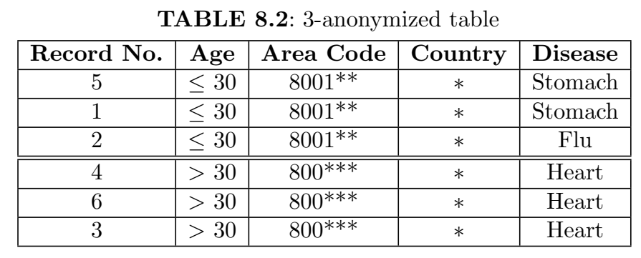

Slide 8
Drawbacks of k-anonymity:
In a homogeneity attack, the malicious user is a neighbor and friend of the legitimate user.
Therefore, the malicious user knows the user’s area code and age which is 30+ years.
The malicious user is interested in his friend’s disease as he or she often goes to the hospital.
Now, the malicious user gets the published 2-anonymized table and shortlisted records number 4, 6, and 3 of block 2 with the help of age and
area code.
Hence, the malicious user comes to know that his friend is suffering from heart disease because the sensitive attribute of heart disease is common for all three records.
Hence, we need a diversity of sensitive attributes in each group.

Slide 9
Drawbacks of k-anonymity:
In attack with prior knowledge, let the malicious user knows his other best friend whose age is less than 30 years.
Since he or she is a friend, so, the malicious user knows his or her area code as well.
Now, assume that the malicious user has prior knowledge that he or she eats sufficient fiber-rich foods.
This means that he or she may not be suffering from the flu and he or she may have a stomach-related disease.

Slide 10
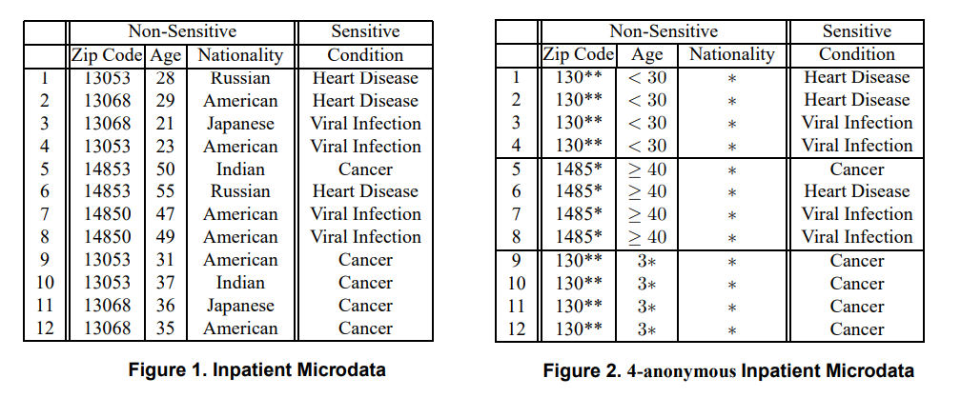
Another example of k-anonymity

Slide 11
Homogeneity Attack:
Alice and Bob are antagonistic neighbors.
One day Bob falls ill and is taken by ambulance to the hospital.
Having seen the ambulance, Alice sets out to discover what disease Bob is suffering from.
Alice discovers the 4-anonymous table of current inpatient records published by the hospital (Figure 2), and so she knows that one of the records in this table contains Bob’s data.
Since Alice is Bob’s neighbor, she knows that Bob is a 31-year-old American male who lives in the zip code 13053.
Therefore, Alice knows that Bob’s record number is 9,10,11, or 12.
Now, all of those patients have the same medical condition (cancer), and so Alice concludes that Bob has cancer

Slide 12
Background Knowledge Attack:
Alice has a pen friend named Umeko who is admitted to the same hospital as Bob, and whose patient records also appear in the table shown in Figure 2.
Alice knows that Umeko is a 21 year old Japanese female who currently lives in zip code 13068.
Based on this information, Alice learns that Umeko’s information is contained in record number 1,2,3, or 4.
Without additional information, Alice is not sure whether Umeko caught a virus or has heart disease.
However, it is well known that Japanese have an extremely low incidence of heart disease.
Therefore Alice concludes with near certainty that Umeko has a viral infection.

Slide 13
k-Anonymity can create groups that leak information due to lack of diversity in the sensitive attribute.
k-Anonymity does not protect against attacks based on background knowledge.

Slide 14
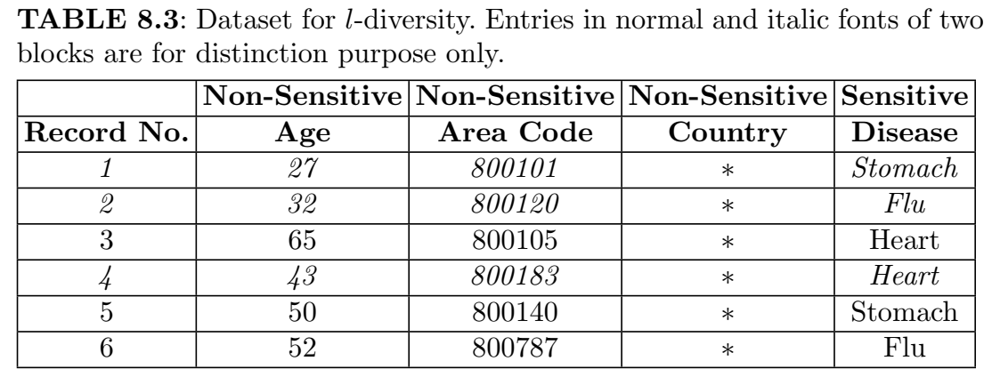
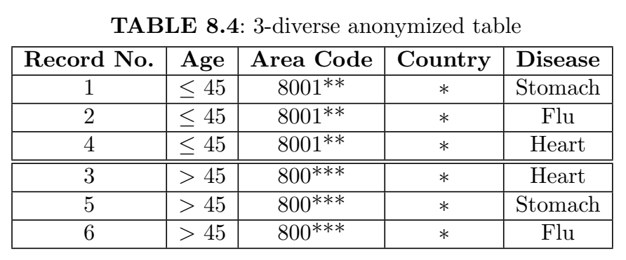
Privacy using l-diversity

Slide 15
Privacy using l-diversity
If a block contains at-least l different sensitive attributes, then it is called l-diverse. If every block of the table is l-diverse, so is the table. Let us consider the dataset of Table 8.3. The 3-diverse anonymized table is in Table 8.4.
In each block, there are 3 records and at least 3 different sensitive attributes, namely, stomach, heart, and flu.
Notably, these two numbers can be different but they must have at least 3 different sensitive attributes.
Now, the malicious user needs at least l − 1 = 2 pieces of prior knowledge to discard two records in each block. In k-anonymity, we need just 1 piece of prior knowledge to obtain the sensitive attribute of a person.
Hence, l-diversity is a better anonymization technique than k-anonymity.

Slide 16
Drawbacks of l-diversity:
At times, it is difficult to achieve anonymity for some problems.
For example, there are only negative and positive test reports of disease.
These are the sensitive attributes and negative attributes dominate, say, 95% of 1000 records.
Most of the blocks contain both negative attributes using 2-diversity.
There can be at-most 5% × 1000 = 50 distinct 2-diverse blocks.

Slide 17
Elliptic Curve Cryptography
Earlier, we had a symmetric key cryptography, where only one key called
private key is used.
The sender and receiver exchange the private key.
This can be vulnerable since it can eavesdrop on the communication medium.
The solution is to use asymmetric key where two keys are used, namely, private and public keys.
The private key is like a password and is kept secretly with each party.
On the other hand, the public key is like an email id and is announced to the external world.
Public key cryptography was developed by Diffie and Hellman in 1976.
Public key cryptography is also called asymmetric key cryptography because it uses two keys: private and public.

Slide 18
Elliptic Curve Cryptography (ECC) was developed by Neal Koblitz and
Victor Miller who had worked at IBM in 1985.
If the RSA algorithm uses 3072 bits public key, then the ECC algorithm uses only 256 bits public key for a comparable level of security.
ECC algorithm uses a smaller key size and hence suitable for IoT networks.
Notably, the elliptic curve has nothing to do with an ellipse.

Slide 19
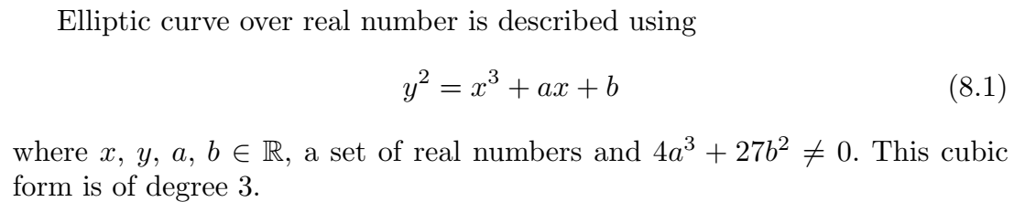
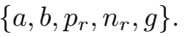
ECC over Real Numbers
ECC uses trapdoor or one way function. That is, given the public key it is difficult to derive the private key. Public and private keys are generated using points of an elliptic curve. The curve is parametrized by
Note that, a and b are the parameters of the elliptic curve. Figure 8.1 shows the elliptic curves for different values of the parameters. Here, pr imposes the maximum limits along the x and y axes. pr is a prime number and used in the elliptic curve over a finite field. nr is a cyclic group and this many times operations are repeated to get a private key. g is the generator or base point on the elliptic curve. This is used to compute other points on the curve.

Slide 20
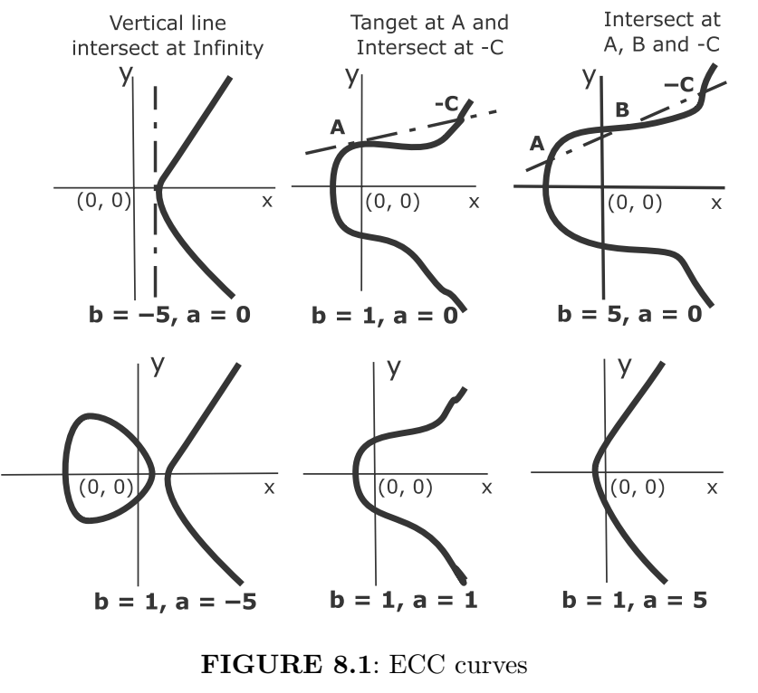

Slide 21
Dot operations over real numbers
Some characteristics of an elliptic curve are as follows:
First, the curve is symmetric about x axis.
Second, if we draw a line, it touches the curve at a maximum of three points.
Third, the curve extends to infinity on both ends.
There are also the following properties:
If a line intersects two points A and B on the curve, then it also intersects a third point, that is, −C on the curve.
If a line is a tangent to the curve at point A, then it also intersects another point −C on the curve.
The vertical line intersects the curve at infinity.
There are two operations called dot operations.
These are called point addition and point doubling. Let us discuss that

Slide 22
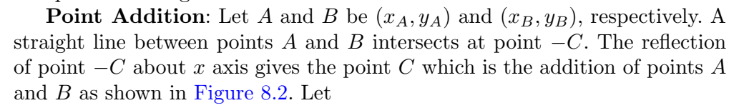
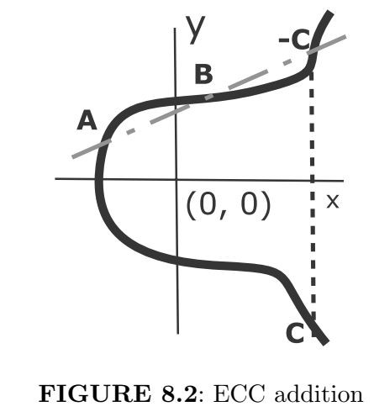
Point Addition

Slide 23
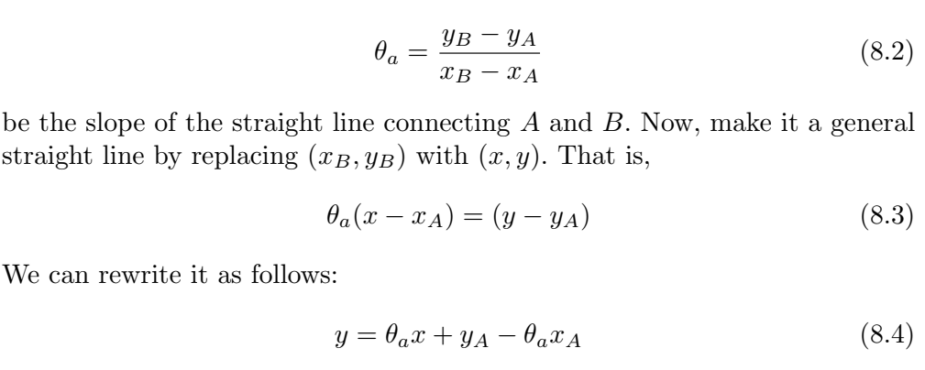
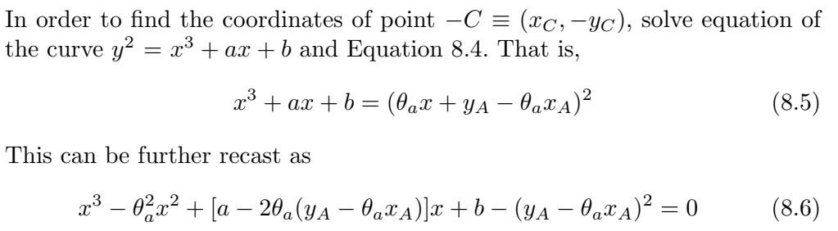

Slide 24
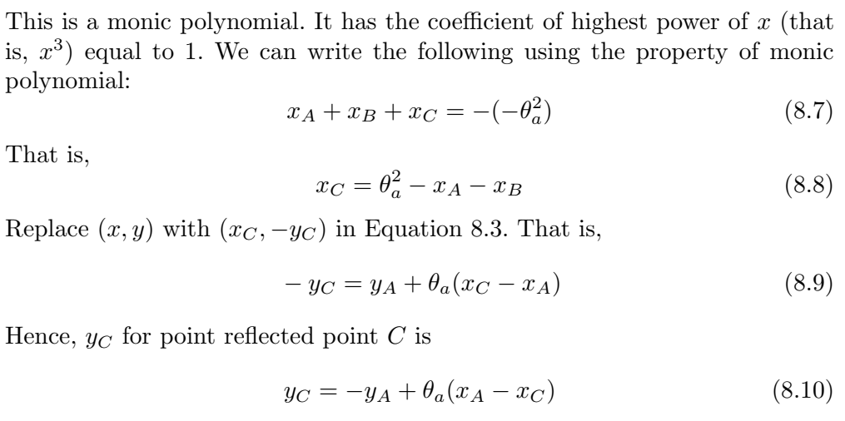

Slide 25
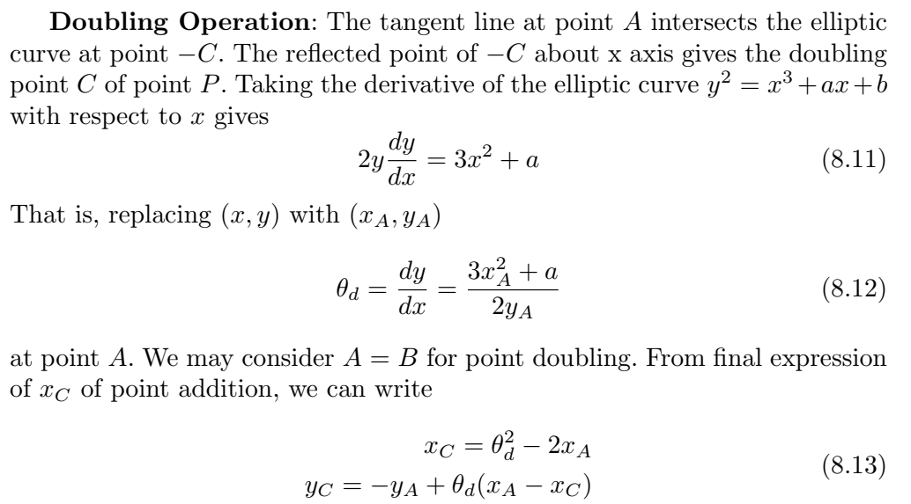
Doubling operation

Slide 26
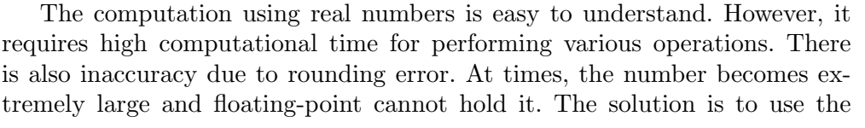
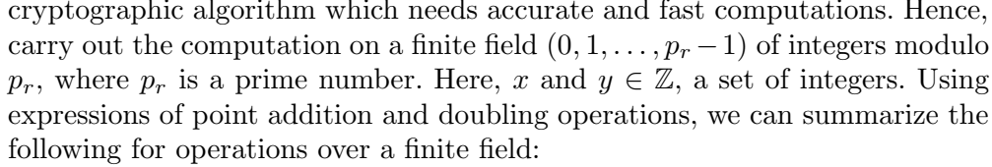
Operations over finite field

Slide 27
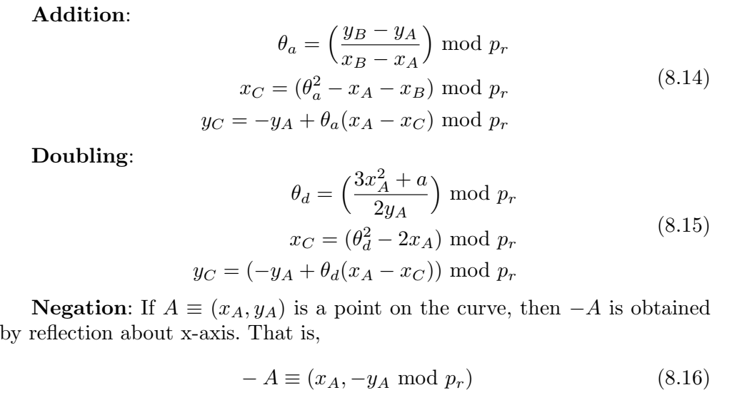
Operations over finite field

Slide 28
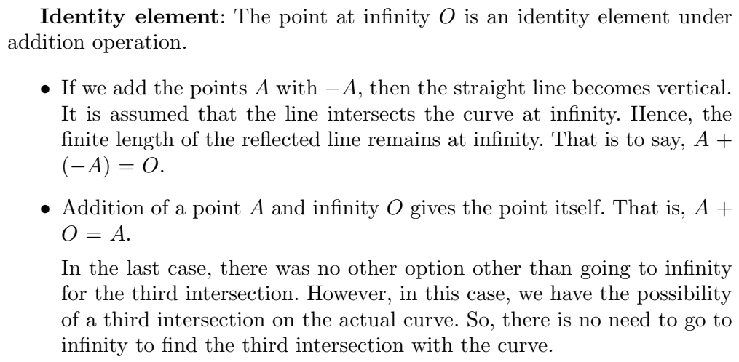
Operations over finite field

Slide 29
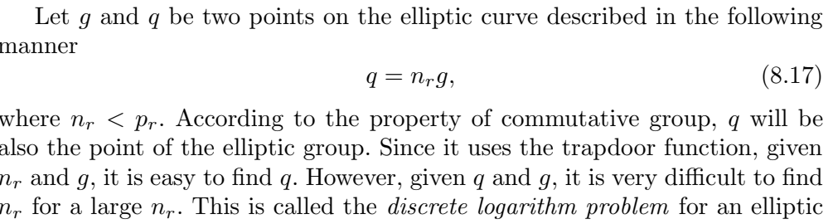
Trapdoor function

Slide 30
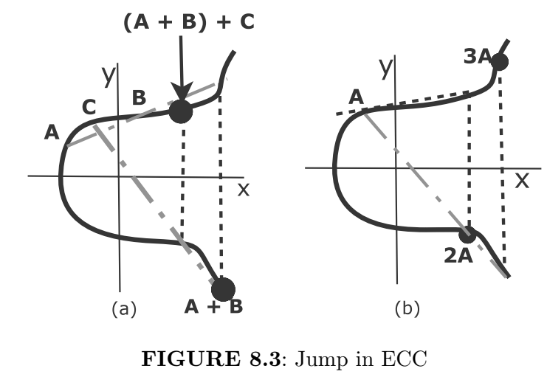
Beauty of ECC

Slide 31
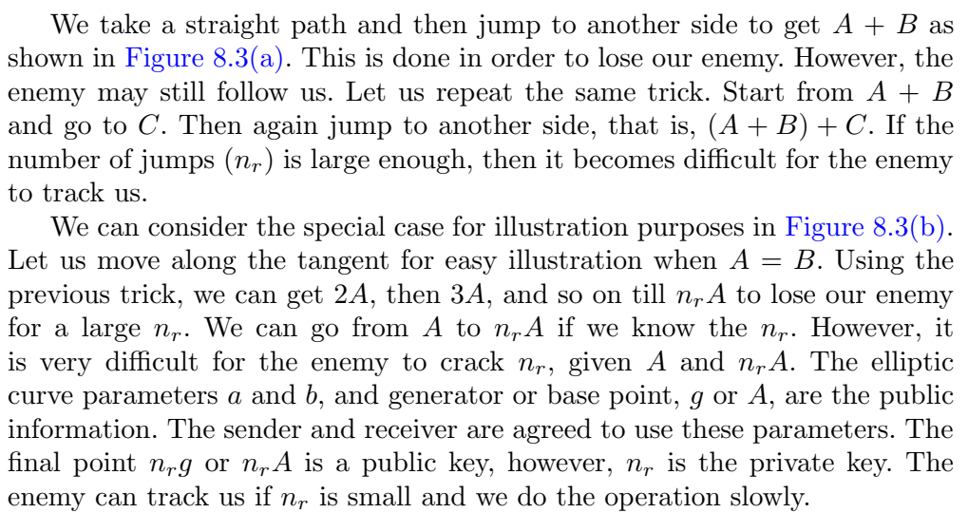

Slide 32
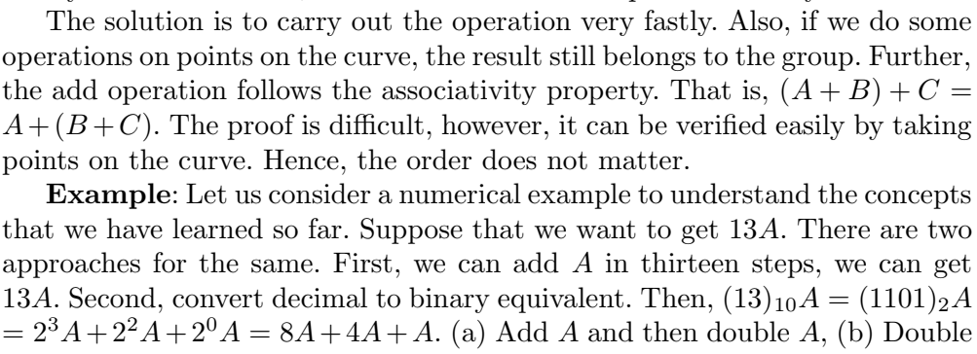
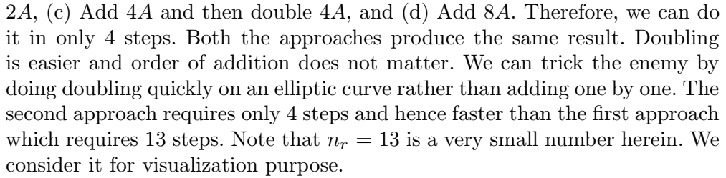

Slide 33
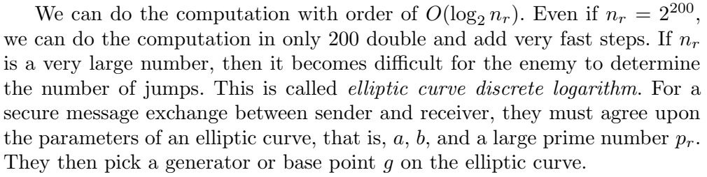

Slide 34
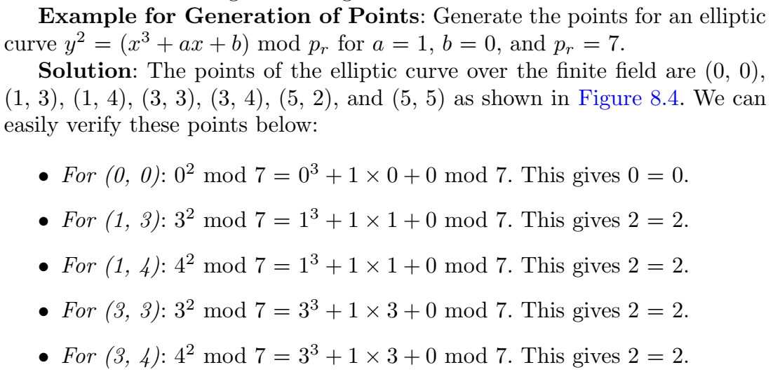
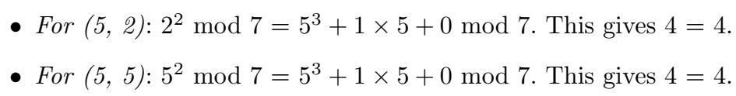

Slide 35
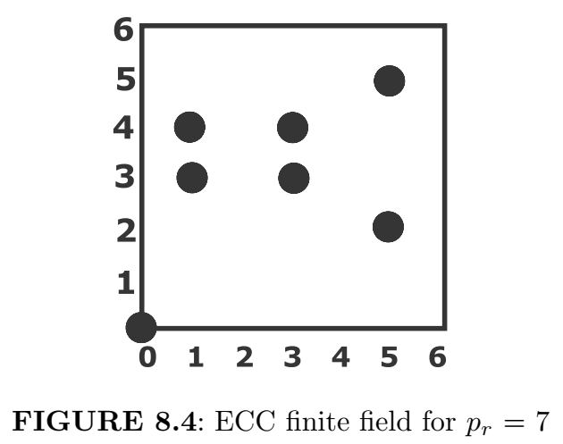

Slide 36
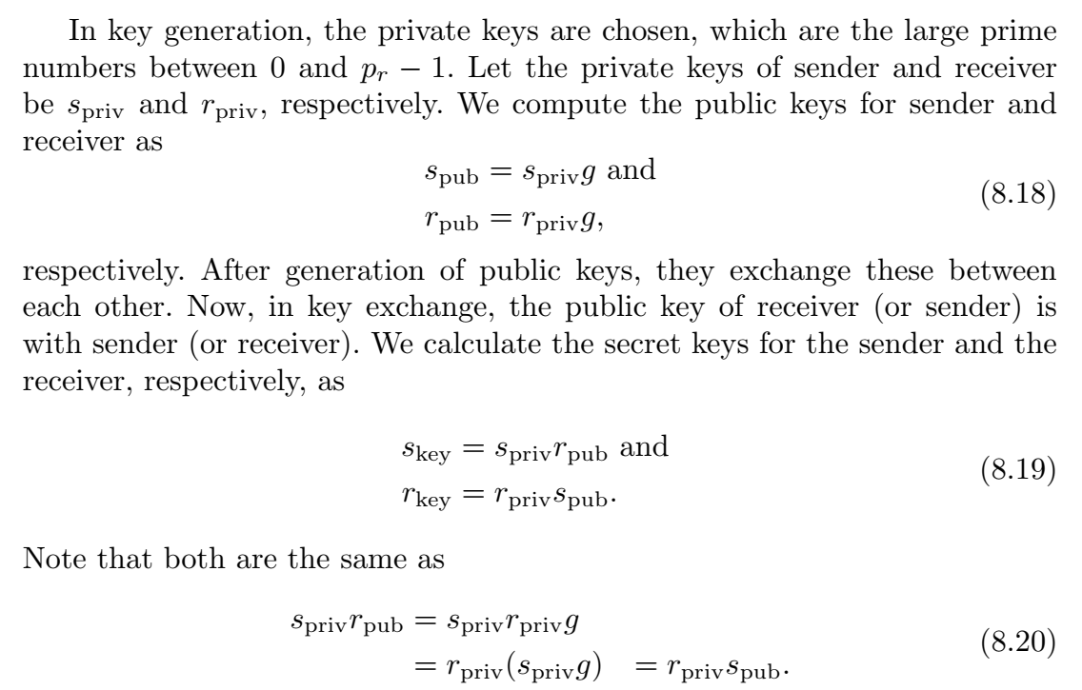
Key Generation and Exchange

Slide 37
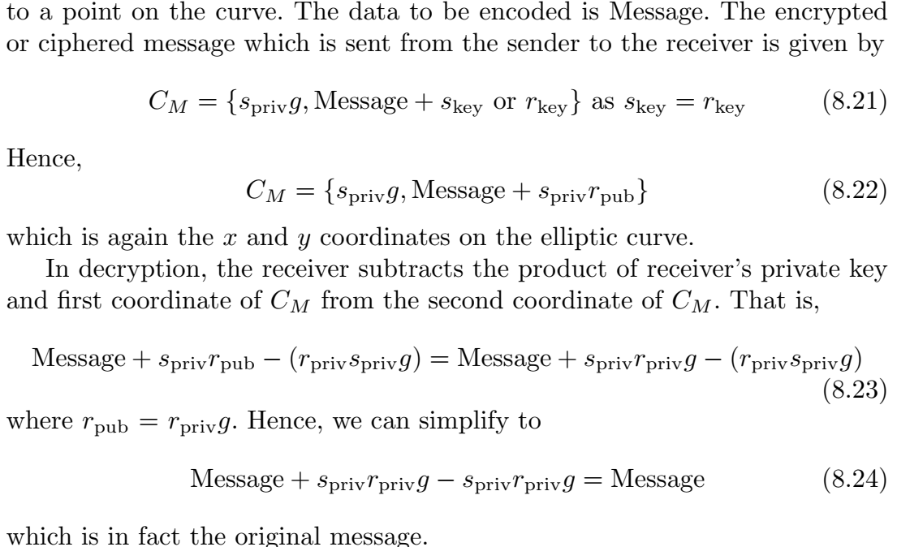
Data Encryption and Decryption

Slide 38
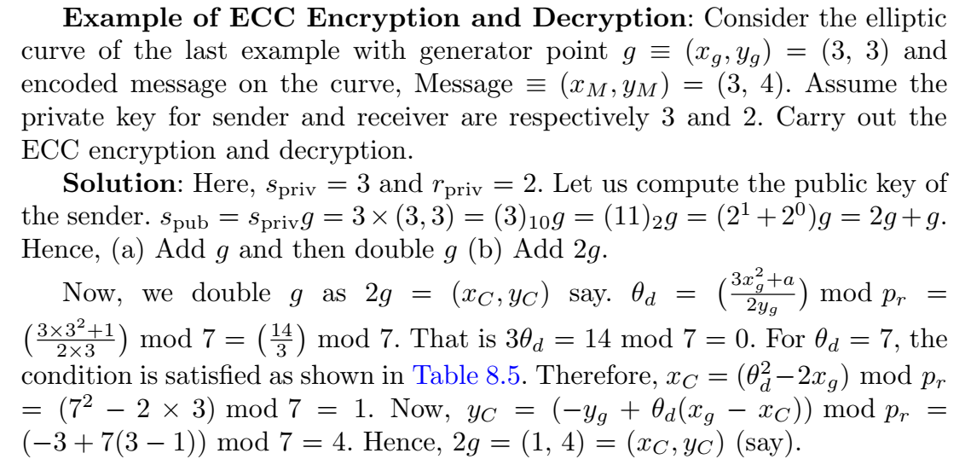
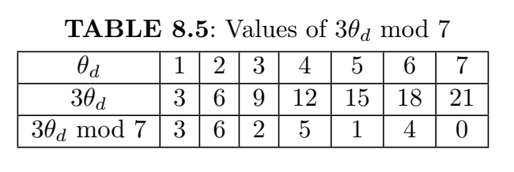

Slide 39
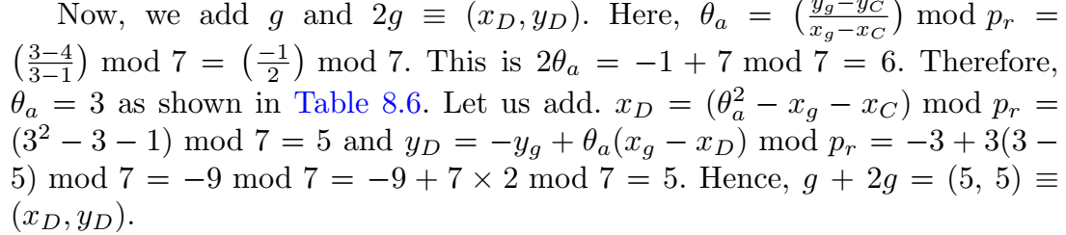
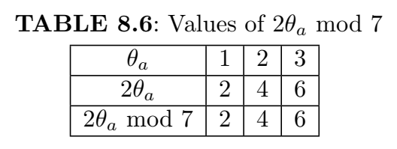

Slide 40
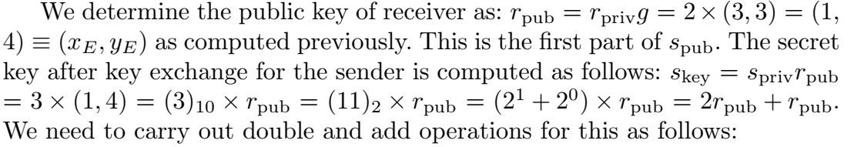
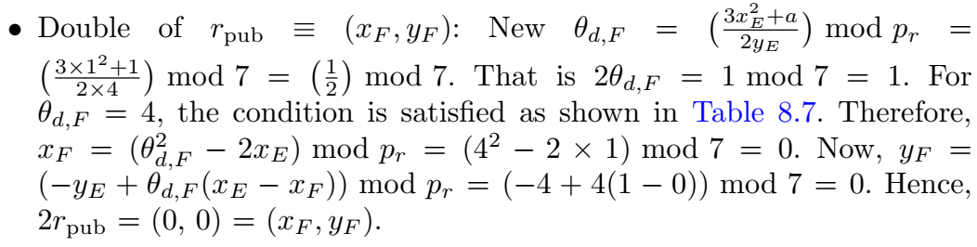
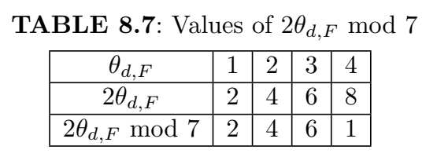

Slide 41
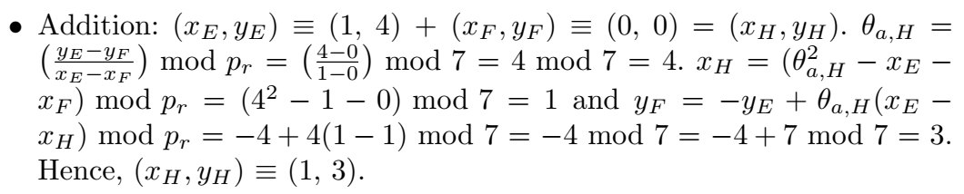

Slide 42
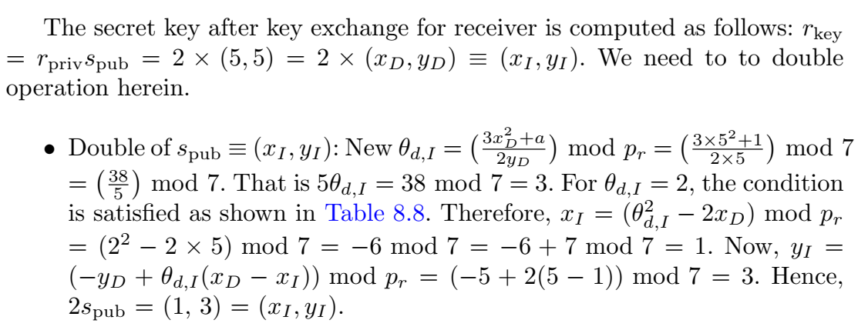
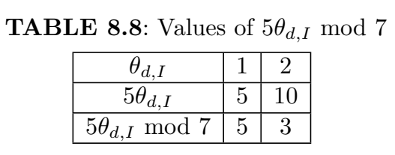

Slide 43
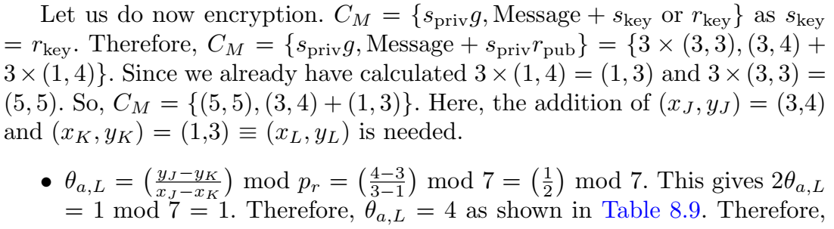
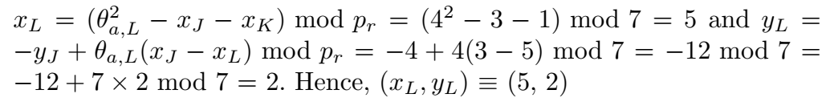
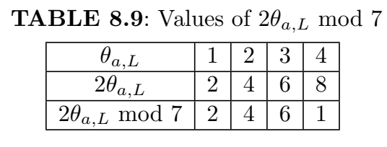

Slide 44
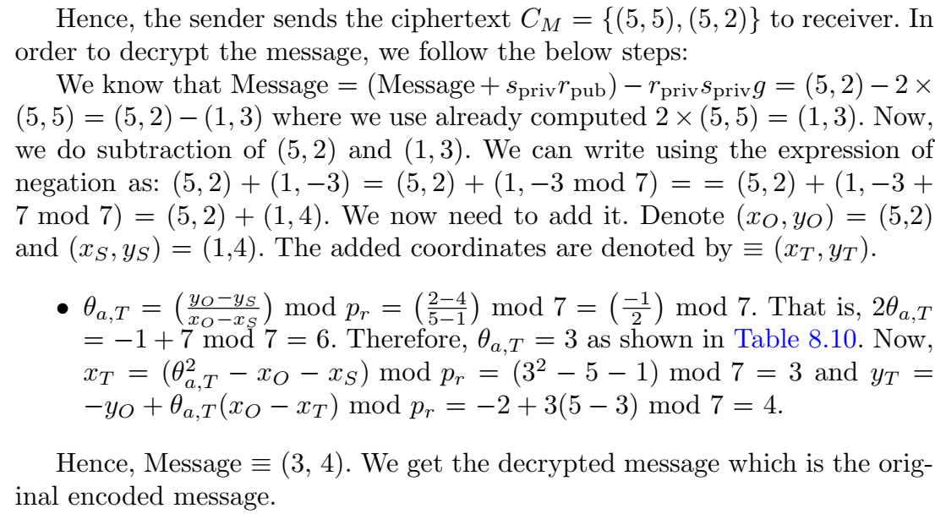
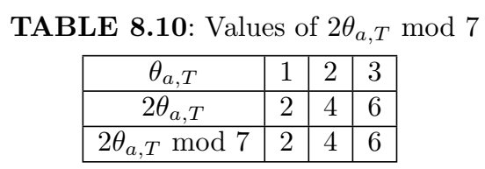

Slide 45
Blockchain
Blockchain was introduced in 2008 by Satoshi Nakamoto or a group of people with alias who developed bitcoin. He/they authored a bitcoin white paper titled ‘Bitcoin: A Peer-to-Peer Electronic Cash System’.
Blockchain is a shared, immutable ledger that facilitates the process of recording transactions and tracking assets in a business network.
An asset can be tangible (a house, car, cash, land) or intangible (intellectual property, patents, copyrights, branding). Virtually anything of value can be tracked and traded on a blockchain network, reducing risk and cutting costs for all involved.
In a centralized architecture, there is a single copy of the information. Also, there is a high maintenance cost.
In contrast, the decentralized network distributes the information to all nodes. Blockchain technology decentralizes the entire network.
Data cannot be tampered with in blockchain technology as it is cryptographically secured.

Slide 46
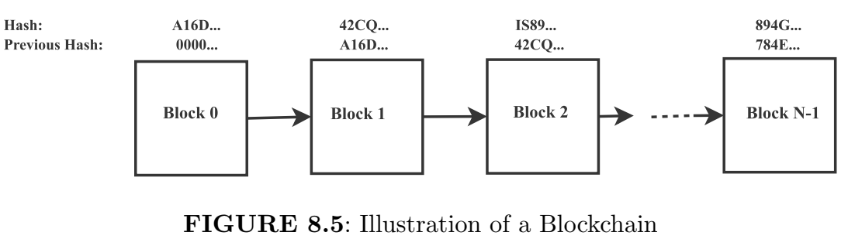
Blockchain is composed of cryptographically linked blocks like a linked list of a data structure and hash as a pointer. That is, there is a chain of blocks in blockchain in chronological order. This is illustrated in Figure 8.5.

Slide 47
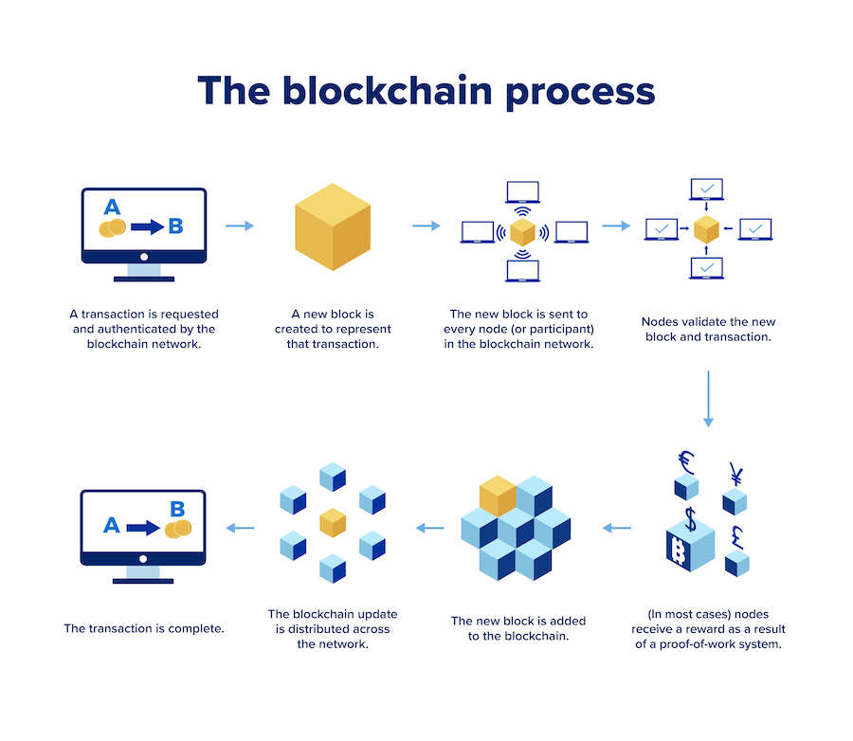

Slide 48
Blockchain and its versions
The blockchain is shared among all the users of the networks.
Each user has the same copy of it and can see the history of transactions.
The details are since the first block was added to the blockchain network.
The first block is also called genesis block.
There are three versions of Blockchain. Blockchain 1.0 is used in digital currency like bitcoin or other cryptocurrencies in a decentralized system.
Blockchain 2.0 is used in smart contracts and the transfer of stock
and bonds.
Blockchain 3.0 is used in government organizations, hospitals, and many more.

Slide 49
Hash
Hash is a function that converts input data of any size to a fixed size of alphanumeric characters. Hash represents each block uniquely. The first block has the previous hash “0000...." as there is no preceding block to it. The “previous hash" of the current block is the “Hash" of the previous block.
Hash Function and Its Properties: The blockchain performs cryptography using hash function. Given an input data, the corresponding hash value is generated.
There are 64 digits in hexadecimal representation or 32 bytes in binary representation. Each digit is mapped to 4 bits in binary representation. Therefore, the total size is 64 × 4 equal to 256 bits. The size of input can be anything and the size of the output is a fixed size of 256 bits for the SHA-256 hashing algorithm. The SHA stands for Secure Hashing Algorithm.

Slide 50
The properties of the hash function are as follows:
It is a one-way function, that is, given the input, the hash value can be computed easily. However, given the hash value, it is very difficult to produce the input back. This is like a trapdoor function in ECC.
It is deterministic, that is, for the same input, the output is also the same.
A small change in the input, there would be a big change in the output.

Slide 51
Steps for creating new block in a ledger
One of the greatest challenges of a decentralized BC network is to guarantee that all nodes of the network maintain the same integrity ledger although nodes may be honest or dishonest. To achieve this purpose, several consensus protocols have been proposed, such as proof of work (PoW), proof of stake (PoS), and delegated proof of stake (DPoS). Among them, PoW is widely belied to be the only consensus that is truly secure enough for a public network.
In a PoW-base BC network, an extensive hash computing effort is applied to trade off system security. In essence, miners on the network perform three steps to add a new block to the ledger, as shown in Fig. 2.
Step 1 selects a set of transaction data that the miner plans to write into the current block and calculates the Merkle tree hash value of this set of data.
Step 2 forms the block header, including the version, hash value of the previous block, Merkle root hash value, timestamp, target, and nonce fields.
Step 3 is the most time- and energy-consuming process. This step hashes the block header by utilizing a SHA. Double SHA-256 has been the most popular algorithm in recent years. In this step, a large number of trials are conducted by computing the double SHA-256 of the header with all possible values of the nonce field until a valid hash smaller than a predefined target is found.

Slide 52
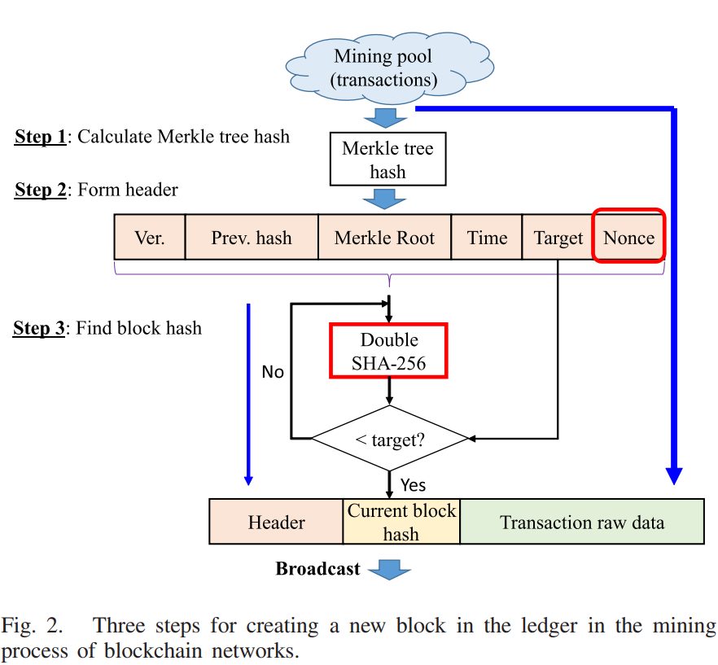
Steps for creating new block in a ledger

Slide 53
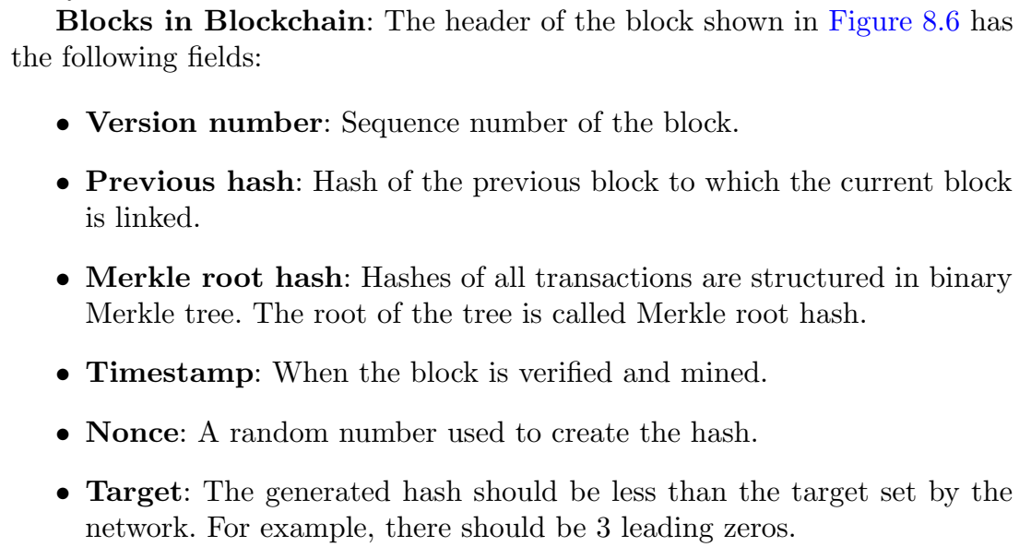
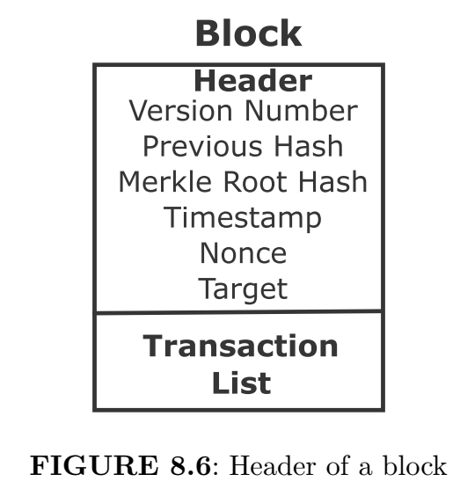

Slide 54
Merkle Root
A Merkle root is the hash of all the hashes of all the transactions that are part of a block in a blockchain network. A blockchain is comprised of various blocks that are linked with one another (hence the name blockchain). A hash tree, or the Merkle tree, encodes the blockchain data in an efficient and secure manner. It enables the quick verification of blockchain data, as well as quick movement of large amounts of data from one computer node to the other on the peer-to-peer blockchain network.
Every transaction occurring on the blockchain network has a hash associated with it. However, these hashes are not stored in a sequential order on the block, rather in the form of a tree-like structure such that each hash is linked to its parent following a parent-child tree-like relation.
Since there are numerous transactions stored on a particular block, all the transaction hashes in the block are also hashed, which results in a Merkle root.1
For example, consider a seven-transaction block. At the lowest level (called the leaf-level), there will be four transaction hashes. At the level one above the leaf-level, there will be two transaction hashes, each of which will connect to two hashes that are below them at the leaf level. At the top (level two), there will be the last transaction hash called the root, and it will connect to the two hashes below it (at level one).
Effectively, you get an upside-down binary tree, with each node of the tree connecting to only two nodes below it (hence the name "binary tree"). It has one root hash at the top, which connects to two hashes at level one, each of which again connects to the two hashes at level three (leaf-level), and the structure continues depending upon the number of transaction hashes.

Slide 55
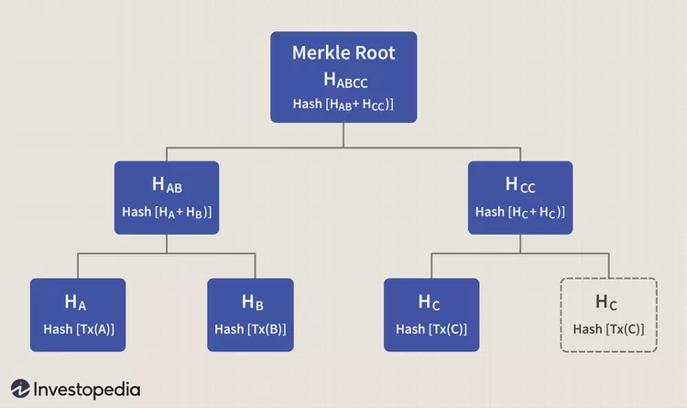
Merkle Root
The hashing starts at the lowest level (leaf-level) nodes, and all four hashes are included in the hash of nodes that are linked to it at level one. Similarly, hashing continues at level one, which leads to hashes of hashes reaching to higher levels, until it reaches the single top root hash.
This root hash is called the Merkle root, and due to the tree-like linkage of hashes, it contains all the information about every single transaction hash that exists on the block. It offers a single-point hash value that enables validating everything present on that block.

Slide 56

Miner
There are three input, namely, previous hash, Merkle root hash and the nonce to SH-256 cryptographic hashing algorithm as shown in Figure 8.7. The miner varies the nonce, while the previous hash and Merkle root remain the same, to generate a hash value lower than the target. If the hash value meets the target set by the networks, then we stop. Otherwise, the process is repeated and this is called proof of work consensus algorithm. All the nodes of the network agrees on the same version of the fact in the consensus algorithm.

Slide 57
Miner-Bitcoin Halving
The miner verifies and validates the transactions and adds the block.
The first miner who gets the hash that meets the target is rewarded.
Since the miner invests resources and computing power, he or she is rewarded for the same in terms of bitcoin or other forms of remuneration.
The miner gets 12.5 bitcoins and the sum of the transaction fee of that block.
The amount is halved every 2,10,000 blocks, which is approximately 4 years.

Slide 58
Tamper–proof Block chain
Let us consider that the attacker tampers the data of block number 3 of Figure 8.5.
Subsequently, the hash value of this block changes.
However, the previous hash value of block 4 remains intact as there is no tampering in block number 4.
Consequently, the changed hash value of block number 3 due to tampering and the previous hash value of block number 4 do not match.
This makes the following blocks invalid. Hence, tampering can be detected in a blockchain network.

Slide 59

Role of Digital Signature in Blockchain

Slide 60
Role of Digital Signature in Blockchain
Confidentiality is defined as the state of keeping secret or private. This is carried out using public key for encryption and private keys for decryption as shown in Figure 8.8(a).
Authentication is defined as the process of showing something legitimate. This is achieved using digital signature as shown in Figure 8.8(b). The digital signature is equivalent to handwritten signature but it is more secured. However, in authentication, we need public key, not private key, to decrypt. We make sure that received message is from the authentic sender.
As shown in Figure 8.8(c), we can achieve both confidentiality and authentication. We do double encryption and decryption at both sender and receiver ends.

Slide 61

Digital Signature
We can also use the SHA-256 hash function in the blockchain. First the original message is passed through an SHA-256 hash function, which gives alphanumeric characters. Subsequently, both hash message and private key of the sender is used for encryption to get a digital signature as shown in Figure 8.9. At the receiver, both the digital signature and sender’s public key are used to get the hash message. If this hash message and the hash message after directly applying the hash function to the data are the same, then the message is not altered during transmission and coming from the legitimate sender.

Slide 62
Transaction in Blockchain
The transaction details are deducted amount for the sender and credited amount for the receiver.
There is no actual transfer of digital currency. Only the transaction is recorded in the ledger of blockchain.
The transaction detail is passed through the SHA-256 cryptographic hashing function.
We know that the private key is secret with the user, while the public key is shared with all the Bitcoin users.
The transaction detail is signed using the user’s private key.
The sender broadcasts the encrypted transactions with amount of bitcoin network to be transferred.
The miner receives the transaction, verifies, and validates it.
The miner then includes it in a block and propagates it to other Bitcoin users.

Slide 63

Distributed Ledger

Slide 64
Distributed Ledger
Distributed ledger is a feature of blockchain. All users have the same copy of a ledger. A blank ledger with no data input also has some hash. Each row is a blockchain, where the “previous hash" of the current block is the “hash" of the previous block. The combination of rows and columns makes it a distributed ledger as shown in Figure 8.10. Note that each row is the same in terms of all parameters. If we write something in any block of some peer, all subsequent blocks turn pink2. This leads to a change in “hash" and “previous hash“ like a linked list. Now, clicking on mine of that block changes the nonce and regenerates the hash such that it has 4 leading zeros to meet the target. This makes that block green and the process is repeated for subsequent blocks of that row. Notably, modification of a block makes all subsequent blocks invalid and these are re-mined.
For example, when we write in the data field of block 3 (say) of Peer A, this generates a hash value that is different from block 3 of peer B or C. Note that the hash values of block 3 of peer B and C are the same as we have not modified their data fields. Hence, the data modification of a block can be easily detected. This was not possible if we have a single copy of the ledger. All the users of the network have a history of transactions since the genesis block which is the first block of the network. Even if a node (computer) gets corrupted, we do not lose the data because the same copy is with other nodes.

Slide 65
Byzantine Generals Problem
Let us assume that there are four generals, out of them, three are loyal and one is a traitor as shown in Figure 8.11.
The loyal general gives the command to attack, while the traitor to not attack.
The generals are not at one place, they communicate among themselves.
The goal is victory even if a minority of the generals are traitors.
In this scenario, the loyal general receives the 2 commands for attack and 1 command to not attack.
The majority of commands are to attack, therefore, they attack the enemy. This is called Byzantine fault tolerance.
On similar lines, in blockchain networks, the generals are the nodes and the messages are the transactions.
Attack command is the legitimate transaction, while to not attack command is the invalid transaction. We arrive at the consensus in the presence of some malicious nodes.

Slide 66


Slide 67
Transaction Pool and Candidate Block
Transaction pool stores all the unverified transactions before getting included in a new block.
Candidate block is a temporary current block that does not have valid proof of work. It is made up of transactions selected from the transaction pool.
The miner picks block number 5 (say) and starts validating.
However, in meantime, some other miners might get the satisfactory hash that meets the target.
The block number 5 does not have a valid proof of work which is mined by miner 2 before miner 1 completes and gets the reward.
Now, miner 1 starts competing for block number 6 by picking the unverified transaction from the transaction pool.

Slide 68
Tie in Generating Hashes or Adding Blocks by Miners
A tie is a rare event, however, we choose the one who finds the hash that meets the target first.
If two miners get the hashes that meet the target at the same time, both add his or her block.
However, two blockchains must not run and only one blockchain needs to be allowed.
We choose the blockchain in which the other miner has added a block first and gets verified by other users in the network. Say, miner 3 adds the block in the second blockchain, then it is accepted as the dominant blockchain. The first blockchain is discarded as shown in Figure 8.12.

Slide 69


Slide 70
Fork
A fork happens whenever a community makes a change to the blockchain’s protocol, or basic set of rules. When this happens, the chain splits — producing a second blockchain that shares all of its history with the original, but is headed off in a new direction.
The blockchain diverges into a different chain with different rules or protocols. The users of networks are not in agreement. Some improvements to be made are minor, while some are major. There are two types of forks.
Soft fork: The new version works well with the old version, that is there is backward compatibility. Hence, there is flexibility.
Hard fork: This is rigid as there are different rules for different chains and the users have to choose one. Both chains are valid and cannot be discarded. Some users support the old chain, while others the new chain.
Example: We have different versions of the same coin, for instance, bitcoin (BTC) and bitcoin cash (B cash or BCH). Initially, we had a block size of 1 MB with a lesser number of transactions. With the popularity of Bitcoin, the number of transactions has been increased. Therefore, we need a larger block size of 8 MB for bitcoin cash since August 2017.

Slide 71


Slide 72

Bitcoin vs Ethereum

Slide 73
Bitcoin vs Ethereum
There are more than 1600 crypto-currencies. For example, Bitcoin, Bitcoin cash, Ethereum, Litecoin, and many more.
Ether cash of Ethereum network is used for peer-to-peer transactions like bitcoin. In addition, it is used for the creation and execution of the smart contracts on a decentralized network.
Transaction in the bitcoin network is slow and takes about 10 minutes.
In the Ethereum network, it is fast and takes about 15 seconds. Bitcoin uses SHA-256 cryptographic hashing algorithm, while Ethereum uses ethash algorithm.
The Proof of Concept is used in the Ethereum network.
One gets the chance of mining based on the number of coins he or she owns. The more the stake, the more the chance and mining power.
The one with more stake likely performs genuine validation, otherwise, he or she loses stake if it is invalidated by the rest of the users.
The miner gets a reward of 3 ETH and the sum of the transaction fee for the validation of the block.
The reward does not get halved, unlike the bitcoin network.

Slide 74

Applications of Blockchain

Slide 75
Applications of Blockchain
Money transaction: We know the drawback of a bank and steps for transactions between sender and receiver.
Know your customer (KYC): We do not need to submit the KYC form to each bank separately. Once KYC is recorded in a blockchain network, we can allow accessing the KYC form to each bank.
Voting system: Single vote casting by an electorate; electorate identity information and votes cannot be tampered with and stored permanently.
Healthcare: The medical data can be communicated more securely using blockchain technology. The data cannot be tampered with and lost in the communication channel. Importantly, there would be a single version of data. It removes duplication of medical data and saves a lot of storage capacity and of course the money.

Slide 76
Insurance claim: The medical history of a patient can be stored in immutable records. This prevents the false claim made by the patient.
Smart contract: Based on terms and conditions set using code in the Ethereum network, the smart contract automatically negotiates the parking fee, ordering some repair parts of a machine and payment through the agreement of a smart contract, negotiation of different energy (solar, wind, etc.) of a home in a smart grid system and many more. Smart contract monitors flight status and automatic payment of compensation in case flight get delayed by some hours. The sensors in a vehicle provide real-time conditions of the vehicle and automatic payment of compensation if the vehicle meets an accident.
Retail Management: The sensors collect the conditions of the product. The product can be automatically tracked, and conditions at generation, shipment, and arrival can be verified through history. The contract can be executed between two vendors.
Government Organizations: All the data can be secured, tamper-proof and transparent among stakeholders eliminating paper-based records.

Slide 77
Disadvantages of Blockchain
Below are some drawbacks of blockchain technology that you should know about. They are:
1. Private keys
The blockchain network maintains its high level of security through private keys. It comes in handy when you validate a blockchain address. Moreover, when you open a crypto wallet, you get a private key. It is a password that allows you to withdraw funds from your wallet. By chance, if you lose this key, you cannot withdraw funds from your account. So, you need to store multiple copies of it just so that if you lose the original one, you can rely on one of the copies. The downside is that your crypto wallet is compromised if anyone can access one of these copies. Moreover, unlike your social media or e-mail id password, changing a private key once generated is impossible.
2. Possibility of disruption of network security
Blockchain technology is known worldwide for its top-notch security. However, there is a chink in its armour that you should know of. The validation process in a blockchain is done through miners having a lot of computing power. If you are a miner with enough computing power to control more than 50% of a blockchain's mining hash rate, you can launch a 51% attack. You can prevent transactions from gaining confirmations and even pause payments between users. Also, you can reverse completed transactions leading to double spending on the cryptocurrency. An attack like this is unlikely on bigger blockchains like Bitcoin or Ethereum. However, new blockchains or forked cryptos can suffer massive damage from this activity. Furthermore, there are also instances of fraud in various cryptocurrencies.

Slide 78
3. High costs of implementation
It costs a lot of money to implement blockchain in a company. This capital-intensive investment deters most companies from adopting this technology.
If you are a company owner looking to implement blockchain, you have to hire core blockchain developers and blockchain software developers. This requires substantial funds. After that, you have to create blockchain-based applications. Plus, there are hardware requirements too.
4. Inefficient mining process
Each block in a blockchain is mined through a mechanism called Proof-of-Work. Each miner needs a high-powered computer to compete in the mining process. Many miners may compete to mine a block; only one gets the block rewards. There is a massive waste of energy and resources.
5. Environmental impacts
Mining, minting and validating transactions require high-powered systems to run 24/7. Apart from heavy investments, these processes require a lot of power. This can lead to serious environmental consequences.

Slide 79
6. Storage problems
On a blockchain, all the information is shared across different nodes on the network. In this respect, all the data on a particular blockchain is stored on the hard drive of a miner's system.
As the number of users increases, so will the data; hence, the hard disk space will also need an upgrade. A time may come when a blockchain's total amount of data may exceed the available hard disk sizes.
7. Anonymity
Anonymity is the main selling point of blockchain technology. People may not be able to track your real identity but think on this matter from the money laundering perspective. A person with an anonymous identity can send money to any part of the world, and no one will have a trace of those transactions except for the wallet addresses. Investigations have often found that cybercriminals were using blockchains as money laundering platforms.
8. Immutability
Once you enter information on a blockchain, it becomes unchangeable. If any errors or information need updating, it is simply impossible to do so. On the flip side, this feature is an advantage of blockchain, as the data cannot be violated in any way. But there are always two sides to a coin, and you must be aware of both.

Slide 80
9. Scalability
Each block has a specific capacity to store data. This makes the validation of transactions very slow and tedious. There is no scope to increase the size of the block on a blockchain. Networks like Polygon have features to upscale the transaction speed of Ethereum, which is quite well-known for its slow network speeds. This may be a temporary solution, but the main problem remains unsolved.
10. Hard forks
Hard forks occur when most blockchain members want to implement new rules. It may also happen when a major group on the blockchain wants to create a new cryptocurrency. In this case, the old and new cryptocurrencies operate as separate entities. Many users face difficulties as the new coin is not readily available on exchange platforms upon its release.
11. Legal formalities and regulations
Blockchain still faces regulatory challenges in various parts of the world. Moreover, legal formalities in various countries and regions prohibit the use and application of blockchain technology.

